Slide 1
SETAC ITALIAN LANGUAGE BRANCH ANNUAL MEETING
Nantes, 22 May 2016
SALLE K+L, 16.00 – 18.00 hs

Slide 2
SETAC Italian Branch - SETAC Europe Regional Branch in Italy
http://italianbranch.setac.org/
Council 2015 - 2016
Presidente (Current President): Paola Grenni – IRSA-CNR Roma grenni@irsa.cnr.it
Past President: Maria Chiara Neri - ChemService Srl Milano
Vice-Presidente (Vice-President): Elisabetta Ugazzi - ISAGRO RICERCA (Novara)
Consigliere (member) Divulgazione scientifica e gestione sito web: Anna Barra Caracciolo – IRSA-CNR Roma - Consigliere (member): Cristina Nasci - Thetis Spa, Venezia
Consigliere (member): Cristina Fossi - Università degli Studi di Siena
onsigliere (member): Antonio Marcomini -University Ca' Foscari
Consigliere (member): Silvia Casini - Università degli Studi di Siena
Consigliere (member): Francesco Regoli - Università Politecnica delle Marche Ancona
Consigliere (member): Luciano Morselli - Università di Bologna
Consigliere (member): Paola Gramatica - Università degli Studi dell'Insubria (Varese)
Consigliere (member): Elena Romano – ISPRA Roma
Consigliere (member): Enrico Dinelli – Univeristà di Bologna
Consigliere (member): Andrea Binelli – Università di Milano
Consigliere (member): Sebastiano Carrer– Thetis SpA
Consigliere (member): Aldo Viarengo - Università del Piemonte Orientale
Rappresentante studenti – Andrea Fedele– Università di Padova

Slide 3
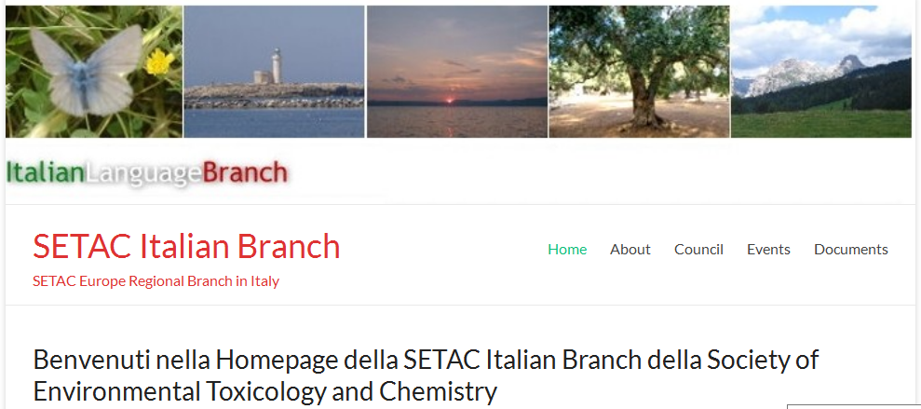
New website: http://italianbranch.setac.org/
SETAC ITALIAN BRANCH

Slide 4
SETAC ITALIAN BRANCH
SETAC IB events 2015-2016
Events organized by SETAC IB:
SETAC ITALIAN BRANCH Annual Meeting, 5/23/2015
Barcelona, Spain

Slide 5
SETAC ITALIAN BRANCH
Events organized by SETAC IB:
MEETING “MONITORING AND CONTROL OF PRIORITY MICRO-POLLUTANTS IN WATER AND REMOVAL TECHNIQUES IN PLANTS TREATING WATER FOR HUMAN CONSUMPTION AND IN WASTE WATER’
Monitoraggio e controllo dei microinquinanti prioritari nelle acque e tecniche di rimozione negli impianti di trattamento delle acque destinate al consumo umano e delle acque reflue
Ecomondo exhibition (Rimini, Italy, 3 November 2015)
10 platform presentations and 6 posters

Slide 6
MIDI2015 Milan Demostrative Initiatives, Innovative solutions for Food Process and preservation http://www.eventbrite.it/e/biglietti-milan-demostrative-initiatives-midi2015-innovative-solutions-for-food-process-and-preservation-16691891898
SETAC ITALIAN BRANCH
Events sponsorized by SETAC IB:
5/26/2015
7/13/2015
9/8/2015

Slide 7
SETAC ITALIAN BRANCH
Events sponsorized by SETAC IB:
Workshop:
The use of GIS software for the creation of relevant environmental variables for ecological studies
Utilizzo di software GIS per la creazione di variabili ambientali rilevanti per studi ecologici
Firenze - 28 maggio 2015
http://www.successionecologica.it/ita/firenze2015

Slide 8
SETAC ITALIAN BRANCH
Meeting of the LCA Italian Network Association (Convegno dell’Associazione Rete Italiana LCA 2016)
Future meetings in which SETAC IB is involved:
23–24 June 2016 in Ravenna
The call for papers topics include:
Life Cycle Impact Assessment: Methodological Developments
Product Environmental Footprint and Organization Environmental Footprint: Experiences and Possible Uses in Environmental Policies
Life Cycle Sustainability Assessment and Their Implementation
Social-LCA, Social Organizational LCA: Applications and Methodological Developments
Life Cycle Costing and Externality Monetization
Life Cycle Assessment and Other Supporting Tools for Circular Economy
Incorporate Energy, Energy and Life Cycle Assessment
Attributional and Consequential LCA: Case Studies and Methodological Aspects
Studies and Application of LCA Models

Slide 9
SETAC ITALIAN BRANCH
Future meetings in which SETAC IB is involved:
XV Italian-Hungarian Symposium on Spectrochemistry (IHSS) Pharmacological Research and Analytical Approach 12–16 June 2016 in Pisa, Italy
Topics: new trends in pharmacological research; the legal framework; advances in analytical techniques; medical devices and current challenges and future prospects; personalized medicine from genetics to analytics; pharmaceuticals and the environment; metabolomics; pharmacology and analytical chemistry, the quest for quality; and nutraceuticals.
A special issue will be publishedon Microchemical J containing selected oral and poster presentations from the symposium.

Slide 10
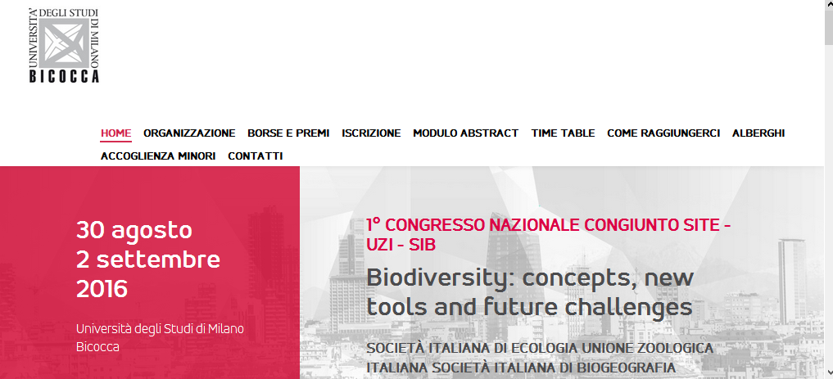
SETAC ITALIAN BRANCH
SITE-Uzi Metting:
Milano-Bicocca, 30 August-2 September 2016
http://www.site-uzi-sib-bicocca2016.it/

Slide 11
SETAC ITALIAN BRANCH
Topics of the common sessions:
Microbial Ecology, Environmental DNA, Italian endemisms
Registration: 30 June 2016
Other Topics:
Zoologia sistematica
Ricostruzioni filogenetiche
Genetica di popolazione
Dinamiche evolutive delle popolazioni
Morfologia e morfologia funzionale
Aspetti citologici e istologici
Fisiologia e immunità animale
Biologia animale e dei modelli
Strategie riproduttive
Zoologia applicate
Comunicazione animale e cellulare
Eco-etologia
Conservazione
Rigenerazione e differenziamento: modelli per ricerca di base ed applicazioni biotecnologiche
Ecologia funzionale e biodiversità
Ecologia quantitativa e modellistica
Servizi ecosistemici
Ecotossicologia
Ambienti di transizione e marino costieri
Insegnamento dell’ecologia ed educazione alla sostenibilità
Environmental DNA
Ritmi di attività e orologi biologici in animali e piante
Ambiente sotterraneo e ambienti estremi
Eco devo evo
Sostenibilità
Ambienti profondi del Mediterraneo
Specie aliene

Slide 12
SETAC GLOBE - http://globe.setac.org/
SETAC ITALIAN BRANCH
COMMUNICATION ACTIVITIES
12 May—Volume 17 Issue 5, http://globe.setac.org/2016/may/italian-branch.html

Slide 13
On a TV screen at the SETAC Square (booth) during the annual meeting in Nantes:
We prepare a slide for Italian Language Regional Branch

Slide 14
SETAC ITALIAN BRANCH
2018…..
SETAC Annual Meeting will be held in Rome!

Slide 15
SETAC Italian Branch - SETAC Europe Regional Branch in Italy
http://italianbranch.setac.org
Council 2016 – 2017
Presidente (Current President): Paola Grenni – IRSA-CNR Roma grenni@irsa.cnr.it
Past President: Maria Chiara Neri - ChemService Srl Milano
Vice-Presidente (Vice-President): Elisabetta Ugazzi - ISAGRO RICERCA (Novara)
Member: Cristina Nasci - Thetis Spa, Venezia nascic@gmail.com
Member: Cristina Fossi - Università degli Studi di Siena Fossi@unisi.it
Member: Antonio Marcomini - University Ca' Foscari, Venezia marcom@unive.it
Member: Elena Romano – Sedimentology and Environmental micropaleontology lab. - ISPRA Roma, elena.romano@isprambiente.it
Member: Enrico Dinelli – Univeristà di Bologna, enrico.dinelli@unibo.it
Member: Andrea Binelli – Università di Milano, andrea.binelli@unimi.it
Member: Sebastiano Carrer– Thetis SpA Venezia, Sebastiano.CARRER@thetis.it
Member: Aldo Viarengo - Università del Piemonte Orientale, viarengo@unipmn.it
Member: Claudia Vaj, - Dow AgroSciences Italia, Indianapolis · R&D – Regulatory, vaj@dow.com
Member: Federica Cacciatore - ISPRA dipartimento II - Prevenzione e mitigazione degli impatti (STS Chioggia), federica.cacciatore@isprambiente.it
Member: Ester Papa - Università degli Studi dell'Insubria (Varese), ester.papa@uninsubria.it
Member: Elena Fabbri - Università di Bologna, elena.fabbri@unibo.it
Student Members:
Andrea Fedele– Università di Padova- http://www.cesqa.it andrea.fedele@unipd.it
Simone Bagnis - Biogeochemistry Research Centre, Plymouth University
simone.bagnis@plymouth.ac.uk

